Slide 1
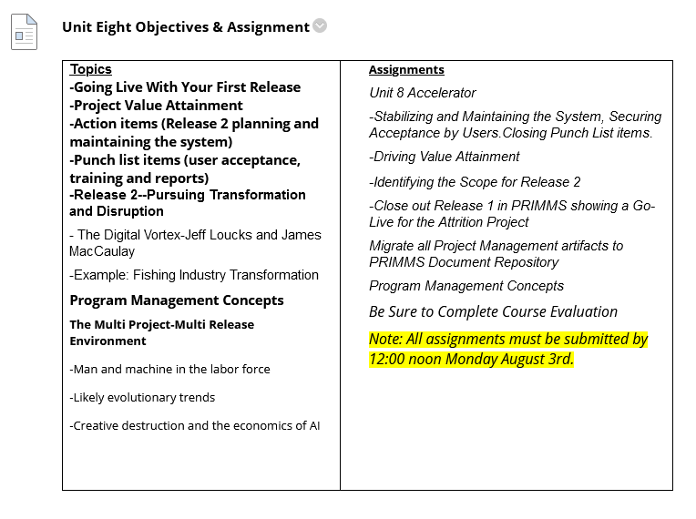
Note: All Assignments and Deliverables are Due by Monday, August 3rd at 12:00 noon.

Slide 2
Some Observations on Homework
The MSBNX nodes allow either a) setting up bar charts for assigning probabilities or b) an “evidence” input with a probability of 1.0. But a node will not allow both. Also, the tripwire is either a 0 or 1, and difficult to imagine any other value in practice.
Overall, recommendations were appropriate. They were evidence based, considered both economics and safety and made overall sense. Some creative ways to combine results of machine learning with decision analysis. See discussion board.
The value of what you are doing with these tools is providing a structured approach to decision making which greatly aids group and senior level decision making. Tonight we will build on that further and be in a position to close out the “Deployment” phase.
Tonight we will build upon this by exploring the role of psychology in explaining decisional conflict and the ways of dealing with this.

Slide 3
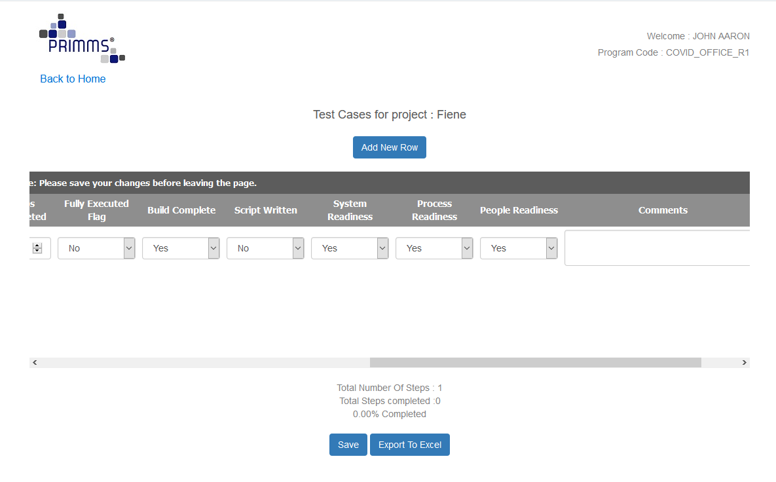

Slide 4
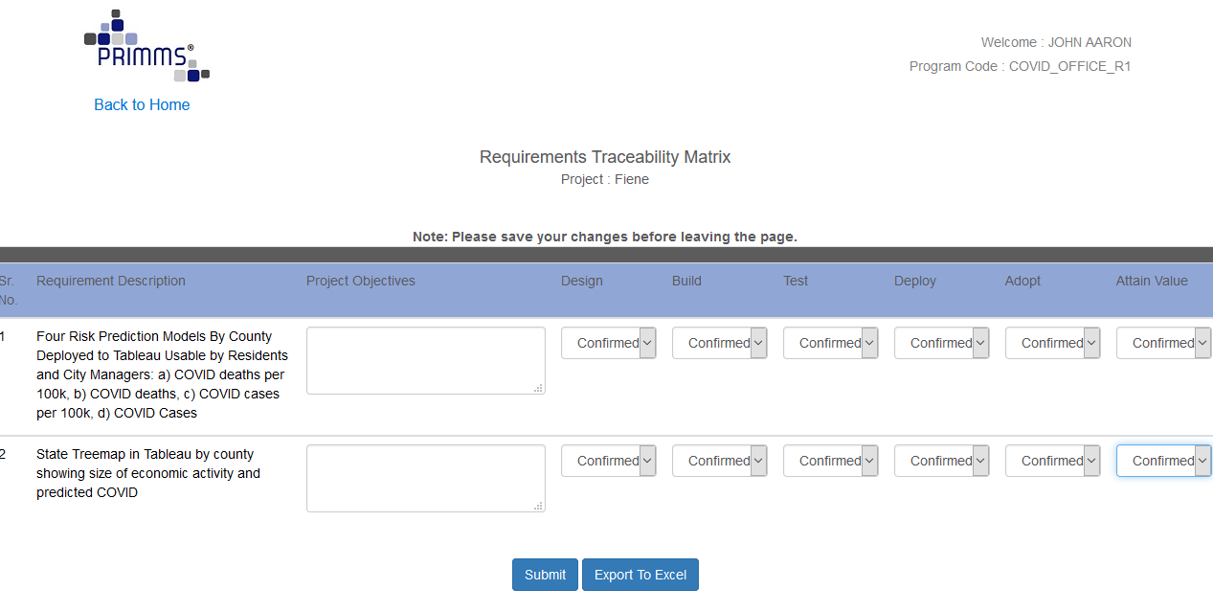

Slide 5
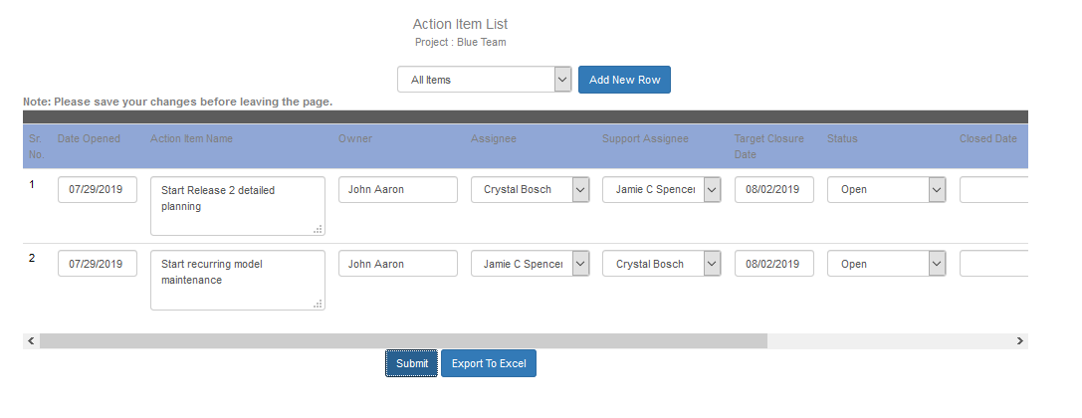

Slide 6
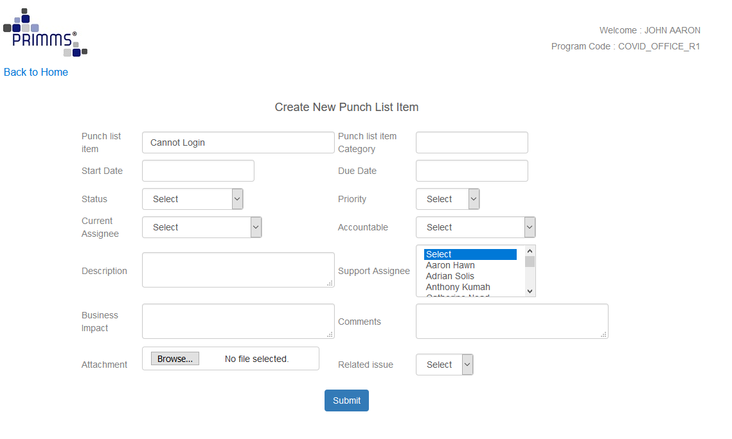
The Final Phase of the Deployment—Go Live With the System

Slide 7
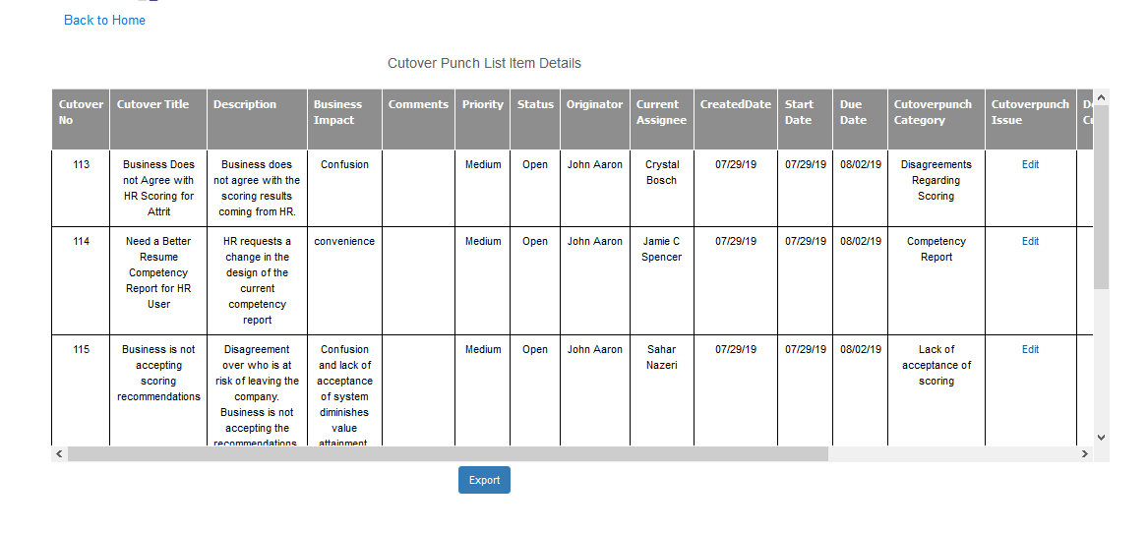

Slide 8

COVID Case Study Driving Value: Decision Making
Notes:
Some high profile examples……The Eastman Kodak company developed the first digital camera in 1975, then proceeded to sit on it (and the core technology for the cell phone, as well). They decided not to develop it because they were afraid it would cannibalize their film business (at one point they had a 90% share of the US film market.)
Say cheese, part II. In the early ’80s, Fuji entered the US film marketplace with lower-priced film and supplies, but Kodak management believed that US consumers would never abandon their homegrown brand. In 1984, Kodak passed on the chance to be the official film of the 1984 Los Angeles Olympics. Fuji won the rights, which gave them the strong foothold they needed to catalyze their growth in the US marketplace.
Kodak never fully recovered from these and other poor decisions; in 2012 the company filed for Chapter 11 bankruptcy.
Initially Bell Labs, which had invented the transistor a decade earlier, rejected the concept of integrated circuits(IC’s) based on the fact all devices have to work.•The rational was that to have 50% probability of functionality for a 20-transistor circuit, the probability of device functionality must be (0.5)1/20= 0.966 or 96.6%. This was considered ridiculously optimistic at the time.•Today we have IC’s with over several billion transistors
10. 2007: A Slip Off the Razr Edge
Remember how cool the super slender Razr cellphone was? No? That may be because its cool factor evaporated faster than Tiberius cologne at a Star Trek convention (yes, that really is a thing).
At the height of its success in 2006, Razr gave $43 billion Motorola a sharp 22-percent share of the mobile phone market. Within a year, however, the hype and hoopla had all but died. Motorola failed to evolve its popular brand into a smartphone leader and instead was selling off the traditional models at a discount. Slow to market doesn’t quite sum it up.
It wasn’t until 2010 that a new line of Razrs was launched, but by that time the ship had sailed, with iPhones and BlackBerrys proudly standing at the helm.
In four short years, Motorola’s revenues were slashed to $22 billion, and its shares fell more than 90 percent. Unable to make its way back to the top, Motorola Mobility was eventually acquired by Google Inc.
Motorola illustrates the fatal marriage of lack of vision and slowness to act, obviously taking a page out of Kodak’s book.
The former, the important decisions, shouldn’t be made hastily; nor without plenty of inputs from others. For the latter (garden variety), these decisions can be made quickly.
Some decisions are identified in advance as part of the WBS. Others are emergent decisions.

Slide 9
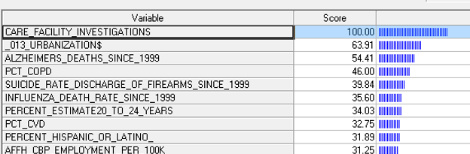
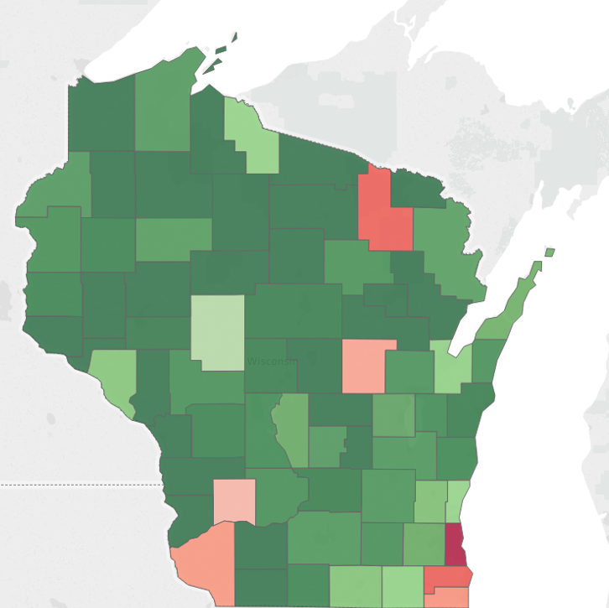
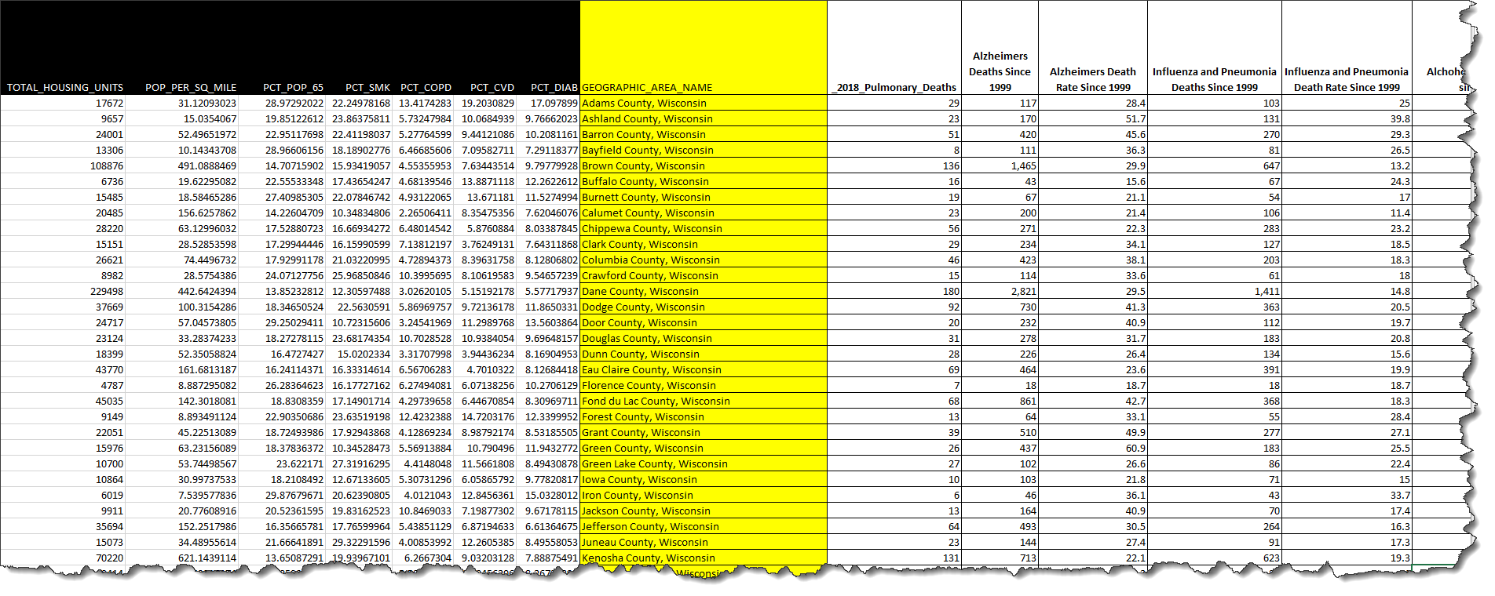
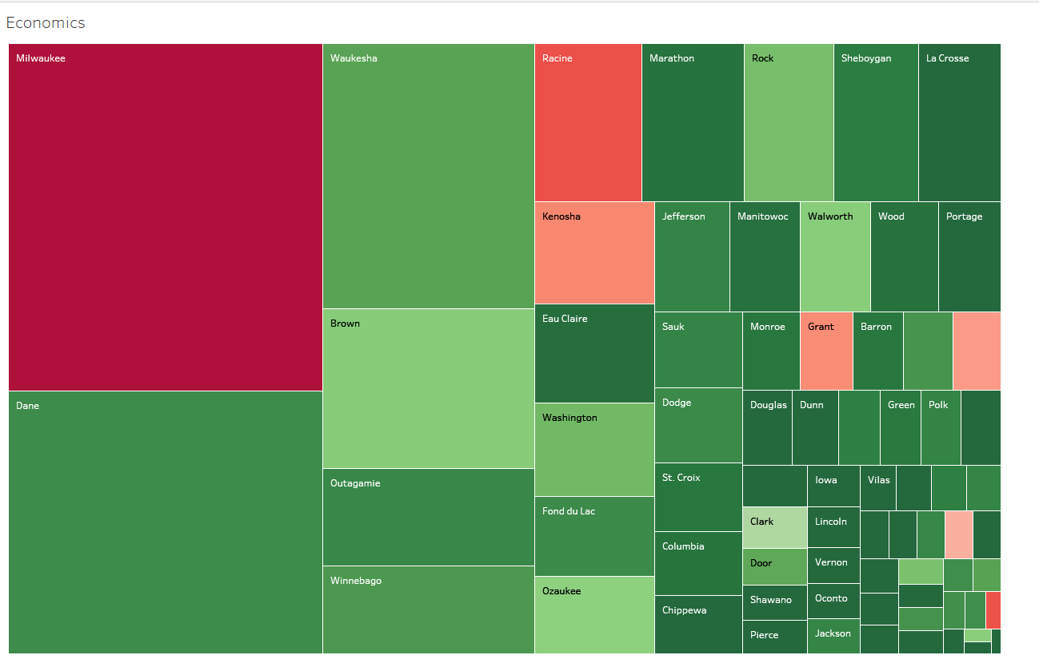
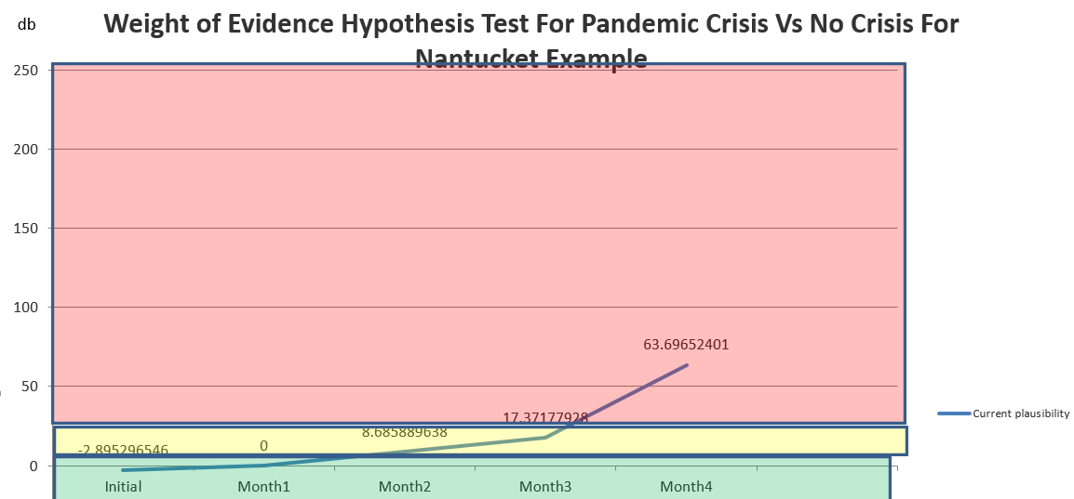
From Tools (Ex. Minitab SPM
Next We Will Add Execution
Planning
Links to Comprehensive List of Data Sources for All Regions (Metro or County Level)
Export to Statistical/Machine Learning Tools (Ex. Minitab SPM)
Variable Importance
Criteria Thresholds
Predictions
Gestalt Understanding
Supported Hypotheses
Discarded Hypotheses
Minitab SPM
Map of Risk By County
Source 1
Source 2
Direction
Source 3
Join
Tableau or Power BI
Data Set
Decision
Analysis
(e.g. Open or Close County)
Treemap of Economic Stakes By County by Safety Risk
Source 4
Source 5
Hypotheses
Tripwire Hypothesis Tests
Histograms
Tables
Maps
Basic Statistics and Tabulations
Trend Graphs
Narratives
Etc
Source k

Slide 10
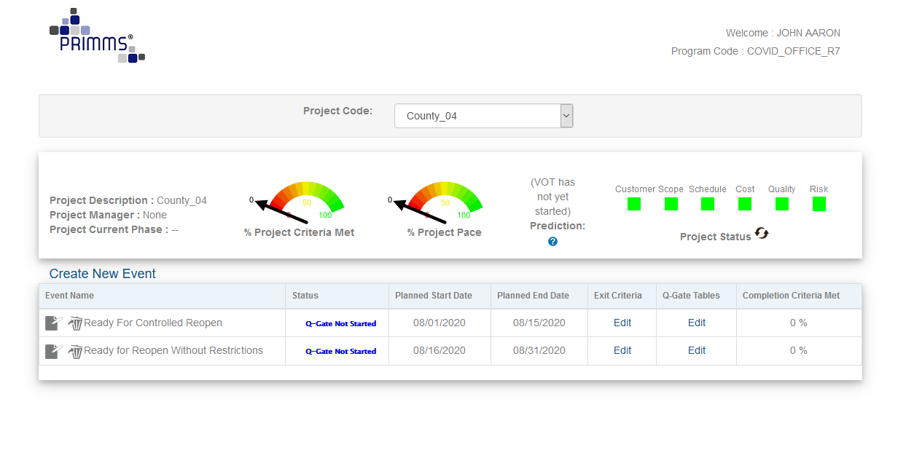
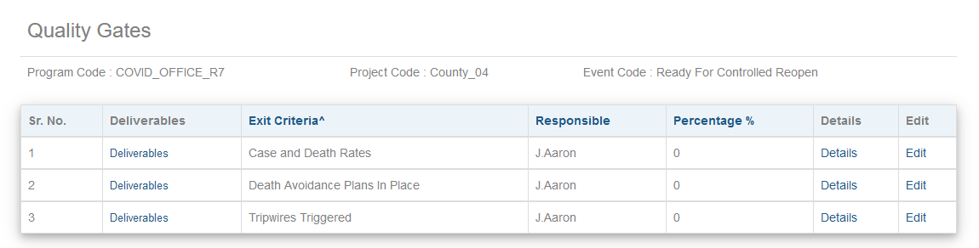
This Sample Plan Has Been Added to Your Program Folder in PRIMMS

Slide 11
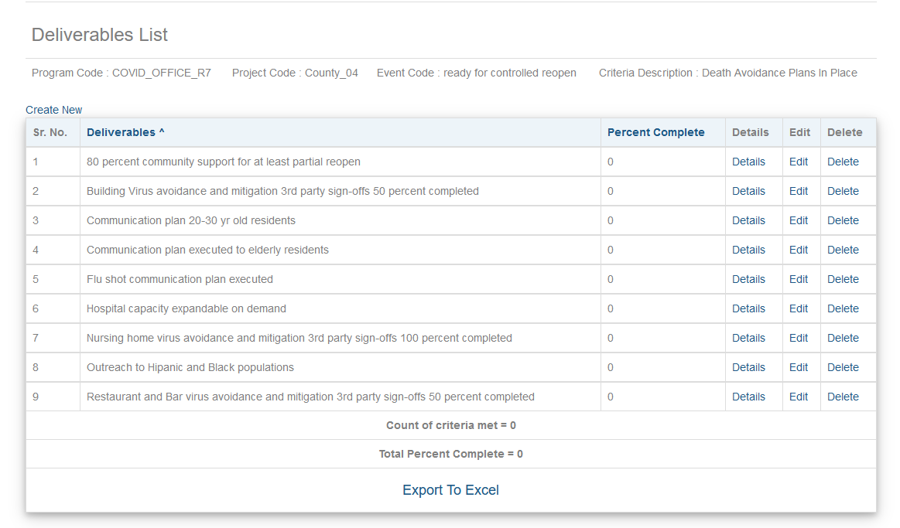
Death Avoidance Criteria To Move From Full Lockdown to Controlled Reopening

Slide 12
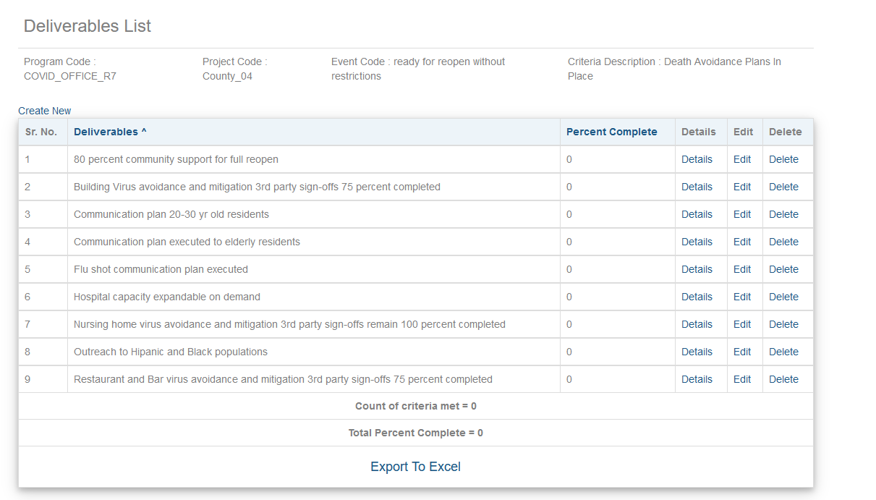
Death Avoidance Criteria To Move From Full Lockdown to Controlled Reopening

Slide 13
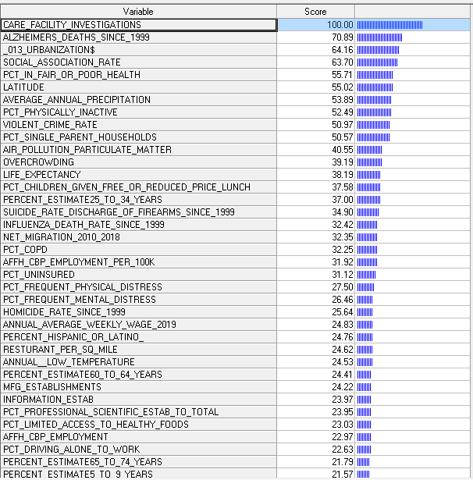
Analytics Are Essential But Are Just Part of the Decision-Making Process
We Have Inserted Economics as a Consideration
Validation of Crisis (Tripwire)
Important Factors
Nursing Homes
Higher Density Urban Areas with all its attendant attributes (air pollution, overcrowding , etc)
Areas historically hard hit by Flu
Demographics (the old die, but the young get)
Prior Mental and Physical Health
Climate/Geography (Further north, cooler, fresher air = safer)
Travel From Other States

Slide 14

Janis and Mann’s Criteria for Ideal Decision Making for Important Decisions
Canvasses Alternatives
Surveys Objectives
Assess Plus, Minus and Risks
Contingency Planning
Searches for Relevant Info….
…Challenge Initial Choice
Re-Examine Before Final Choice
Notes:
Specifically these read as follows:
The decision maker to the best of his/her ability and within his/her information processing capabilities:
Thoroughly canvasses a wide range of alternative courses of action
Surveys the full range of objectives to be fulfilled and the values implicated by the choice;
Carefully weighs whatever he/she knows about the costs and risks of negative consequences, that could flow from each alternative;
Intensively searches for new information relevant to further evaluation of the alternatives;
Correctly assimilates and takes account of any new information or expert judgment to which he/she is exposed, even when the information or judgment does not support the course of action he/she initially prefers;
Reexamines the positive and negative consequences of all known alternatives, including those originally regarded as unacceptable, before making a final choice;
Makes detailed provisions for implementing or executing the chosen course of action, with special attenbtion to contingency plans that might be required if various known risks were to materialize.

Slide 15
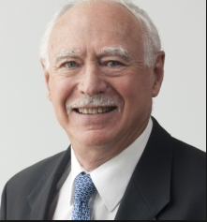
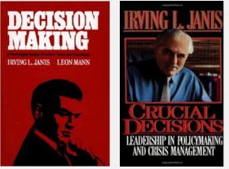
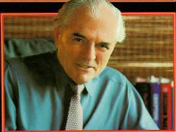
Psychologists Janis and Mann’s Criteria for Vigilant Decision Making for Important Decisions
They provide a very useful framework for project stakeholders to achieve both timeliness and quality.
Notes:
We are grateful for Leon Mann’s review of our paper.

Slide 16
….Important Decisions Generate “Decisional Conflict”
“Decisional conflicts” refer to the simultaneous opposing tendencies within the individual to accept and reject a given course of action.
The most prominent symptoms of such conflicts are hesitation, vacillation, feelings of uncertainty and signs of acute emotional stress whenever the decision comes within the focus of attention.
The difficulties of reversing the decision contribute to the intensity of the decisional conflict.
Such conflicts become acute as the decision maker becomes aware of the risk of suffering serious losses from whatever course of action he/she selects.
Beset with uncertainties, the decision maker is reluctant to make an irrevocable choice and can follow a failing course of action.
Janis and Mann build a strong case for the role of a decision coach….a very suitable role for the data scientist.

Slide 17
Antecedent Conditions
Mediating Processes
Consequences
Start: Challenging Negative Feedback or opportunity
Are the risks serious if I don’t change?
No
Unconflicted adherence
Additional information about losses from continuing unchanged
Low stress
Maybe or yes
Unintended consequences
Information about losses from changing
Are the risks serious if I do change?
No
Unconflicted change
Low stress
Maybe or yes
Decision Traps
Signs of more information available and of other unused resources
Is it realistic to hope to find a better solution?
No
End: Incomplete search, appraisal and contingency planning
Defensive avoidance
High stress
Maybe or yes
Information about deadlines and time pressure
Is there sufficient time to search and deliberate?
No
High stress
Hypervigilance
Maybe or yes
Vigilance
End: Thorough search, appraisal and contingency planning
Moderate stress

Slide 18

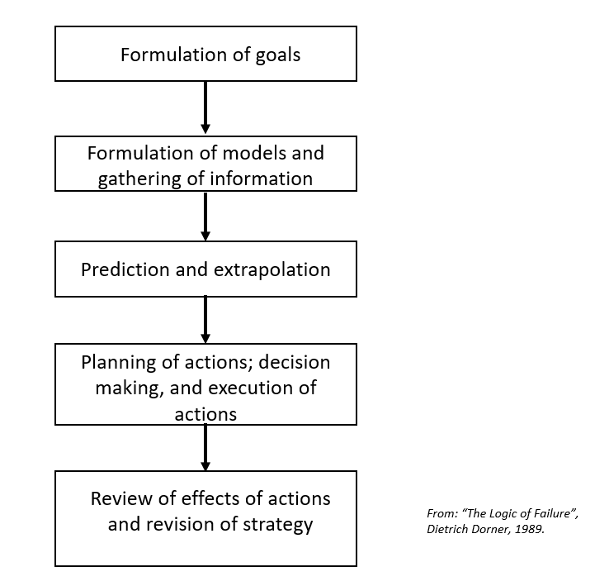

Slide 19
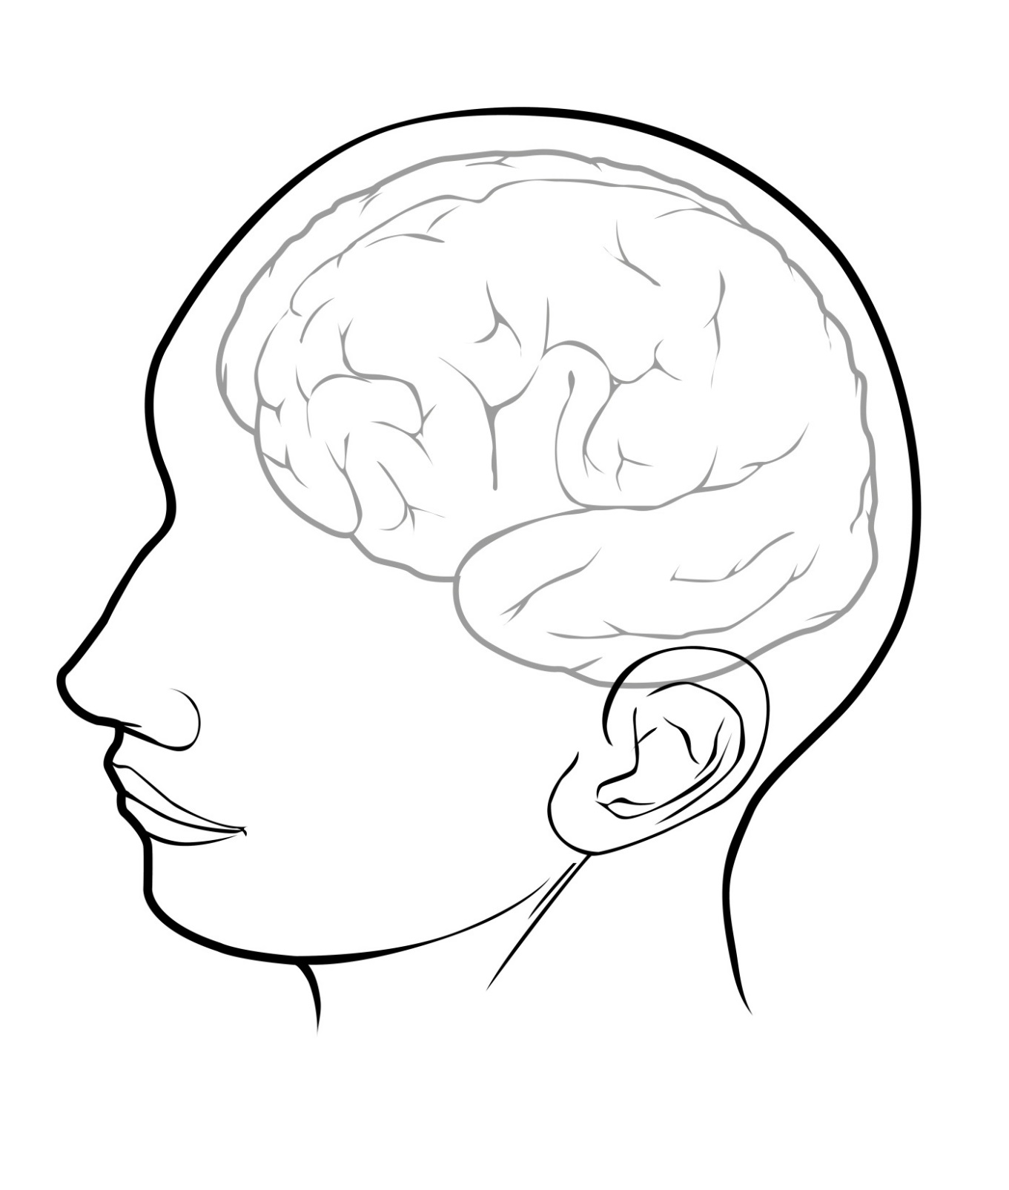
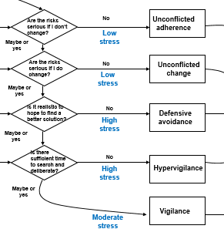
Decision Maker

Slide 20
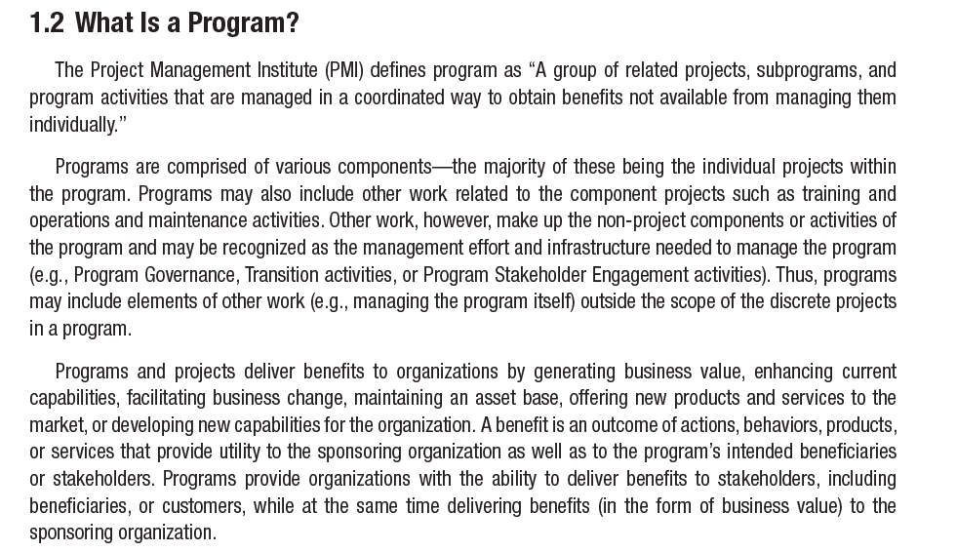

Slide 21
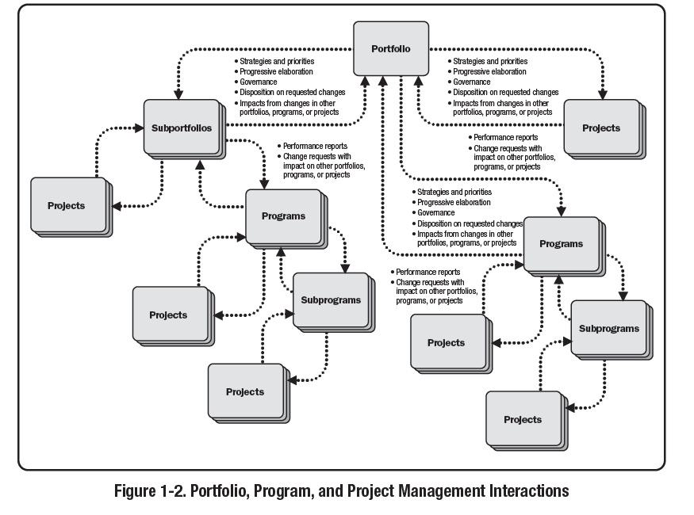

Slide 22
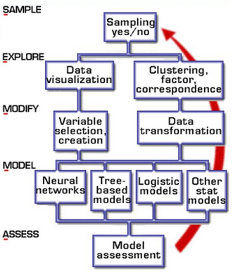
CRISP-DM Iteration #2
The Roadmap
Applying Predictions
CRISP-DM Iteration #k
Progressive Elaboration
CRISP-DM Iteration #1
Coulds and Woulds
Progressive Elaboration
Process Understanding
Musts and Shoulds
Plan
Release 1…………………………
Release k
Project
Prep
Baseline Build and Demos
Evaluation and Prioritization
Building, Testing and Deploying to Users
Data Readiness

Slide 23
CRISP-DM Iteration #2
Sprint #2
Sprint #k
Applying Predictions
CRISP-DM Iteration #k
Sprint #1
Progressive Elaboration
CRISP-DM Iteration #1
Coulds and Woulds
Progressive Elaboration
Process Understanding
Musts and Shoulds
Model Deployment
Scope Verification First Cut Value Props
Release 1…………………………
Release k
Project
Prep
Baseline Build and Demos
Evaluation and Prioritization
Building, Testing and Deploying to Users
Data Readiness

Slide 24
Current Focus For Data Science in the Enterprise
Digitalization: Driving Evolution or Revolution?

Slide 25
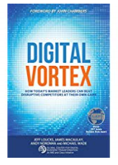

Slide 26
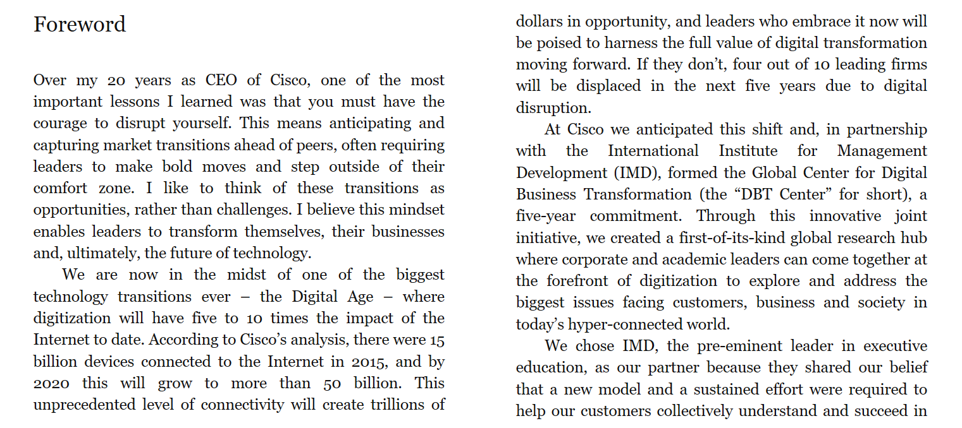
Digital Vortex

Slide 27
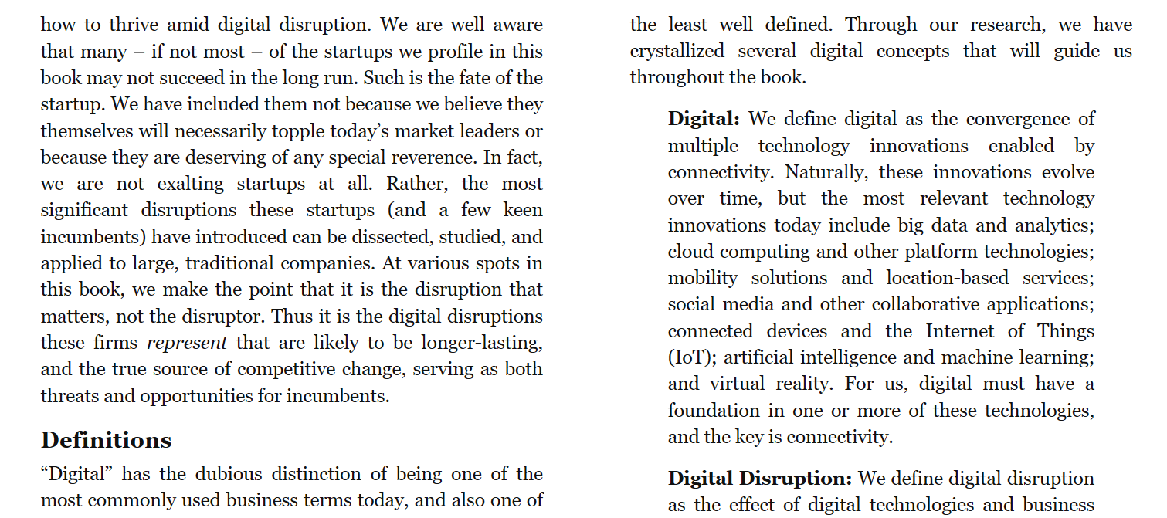

Slide 28
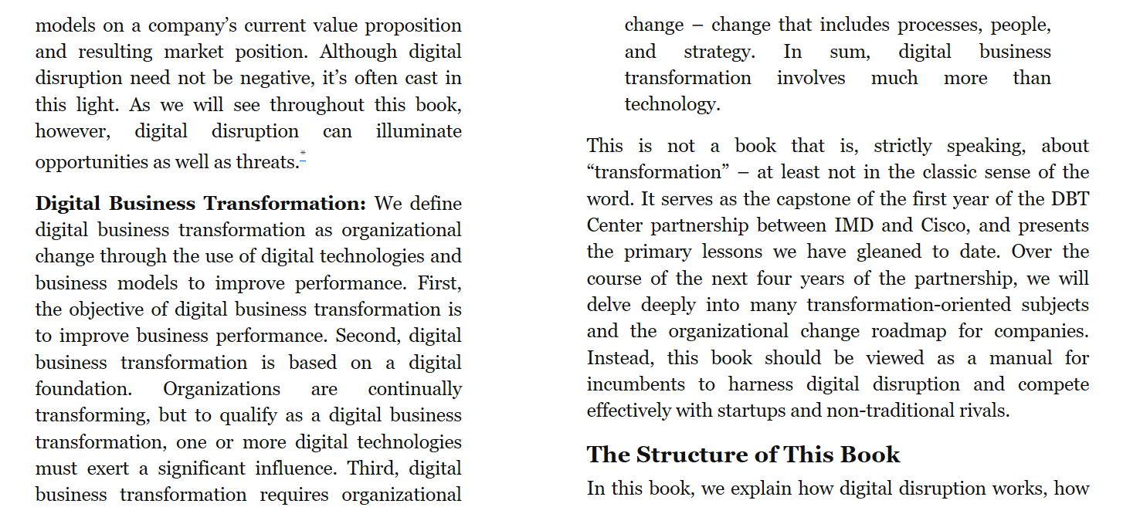

Slide 29
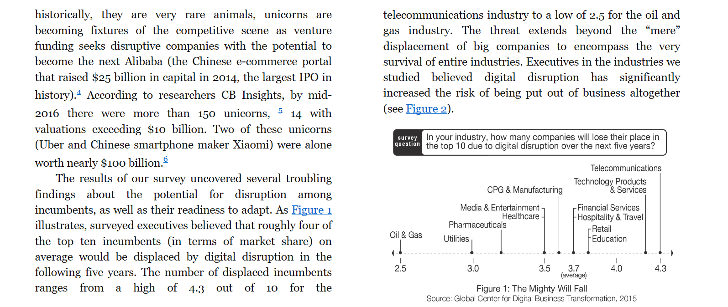

Slide 30
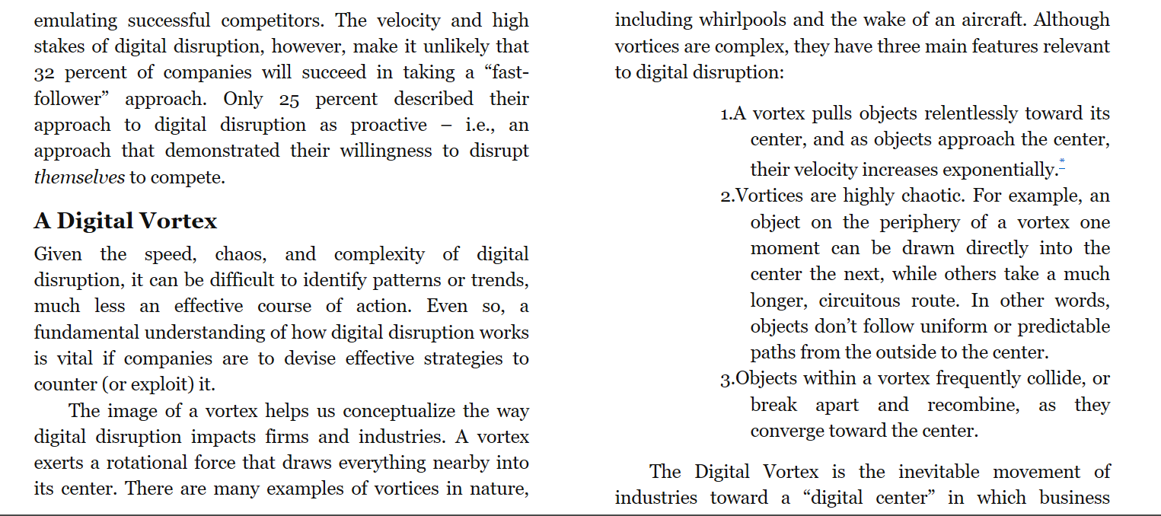

Slide 31
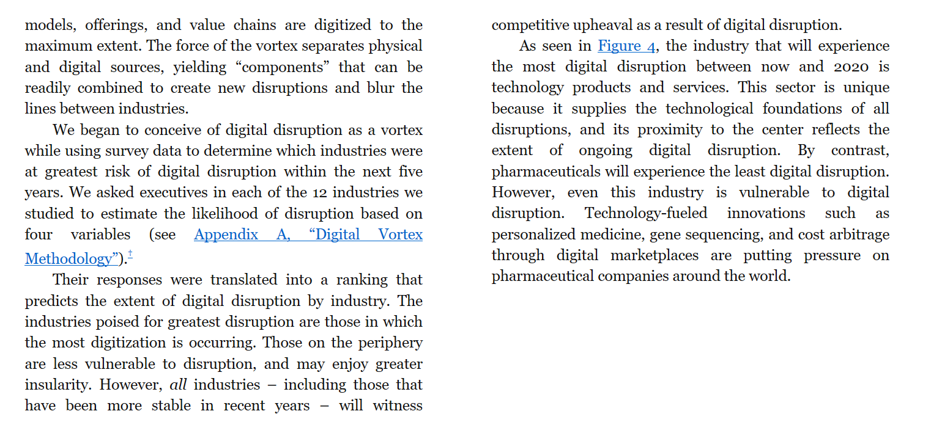

Slide 32
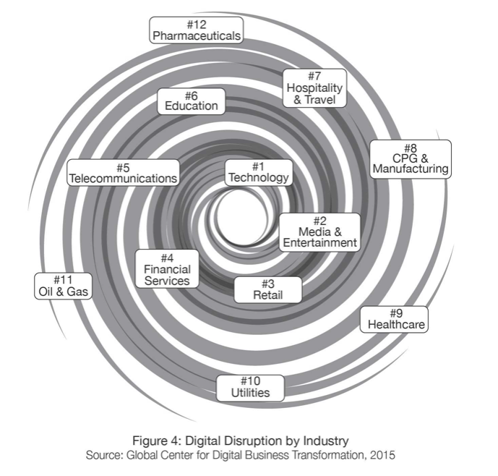
Replacement of the Physical with the Digital
This is just the inevitable continuation of what economist Joseph Schumpeter called “Creative Destruction”

Slide 33
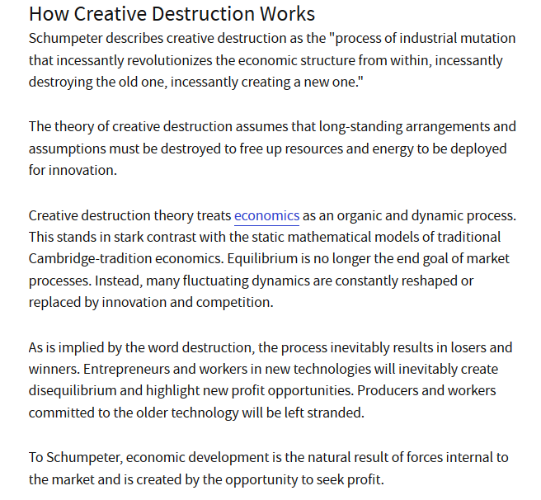

Slide 34
Let’s Take A Case Study—Fish Finding Using Sonar
Assume We Added Machine Learning to Fish Finding
Consider the position of “Good Luck Fisheries, Inc.” during this period. The founder based his profitability on his 4th generation family business in commercial fishing on the family’s unique ability to find large schools of fish by reading the stars.
In the 1950s the family business was one of the first commercial fishing businesses to introduce the analog technology “sonar” to increase the yield of each fishing trip.
Now the current owner wants to add machine learning to better predict where the fish are most likely to be given various weather, weather temperature and other oceanic factors.
Following Schumpeter’s premise, what did the introduction of Sonar do for the economy? Might Good Luck Fisheries expect similar gains in competitive advantage?

Slide 35
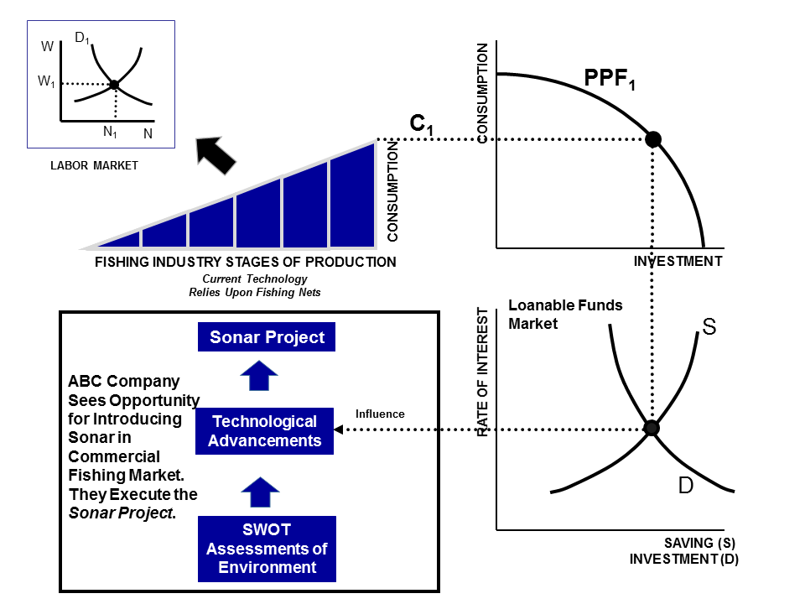
Market Before the Introduction of Fish finding Sonar
Fishing Industry Supply chain

Slide 36
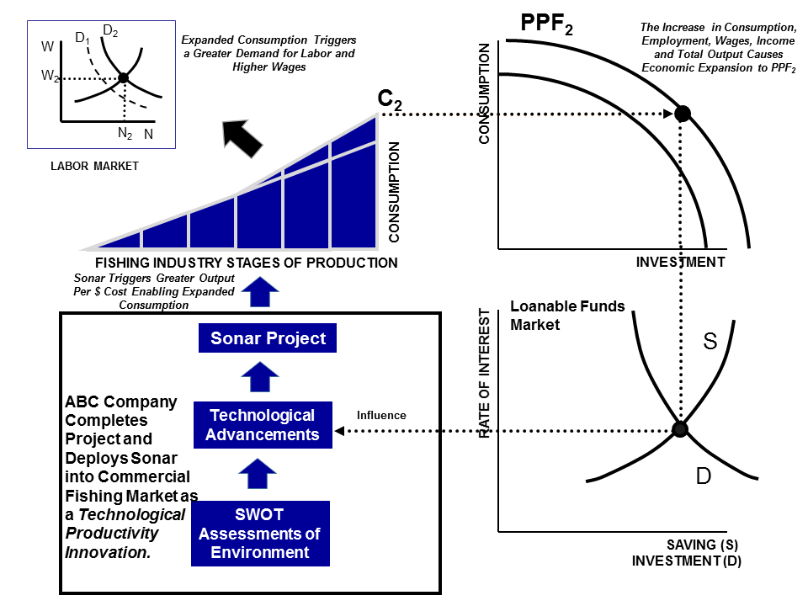
As a Result “Good Luck Fisheries, Inc.” Competitor’s Went Out of Business.
They fell victim the Schumpeter’s creative destruction.
The “Digital Vortex” concept argues that things that are physical will be replaced by things that are digital.
Hence, “Good Luck Fisheries, Inc.” partners with a technology firm and should expect to secure a similar advantage.
Innovation Source

Slide 37
But Does AI Change the Game?
A Quote From I.J. Good
“Let an ultraintelligent machine be defined as a machine that can far surpass all the intellectual activities of any man however clever. Since the design of machines is one of these intellectual activities, an ultraintelligent machine could design even better machines; there would then unquestionably be an 'intelligence explosion,' and the intelligence of man would be left far behind. Thus the first ultraintelligent machine is the last invention that man need ever make, provided that the machine is docile enough to tell us how to keep it under control.”

Slide 38
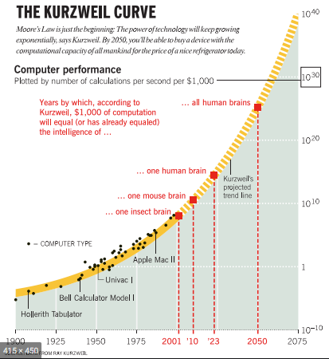
……But Computational Capacity Does Mean Intelligence……….

Slide 39
RPAs To Reduce Manual Process Steps
Release 2 Scope

Slide 40
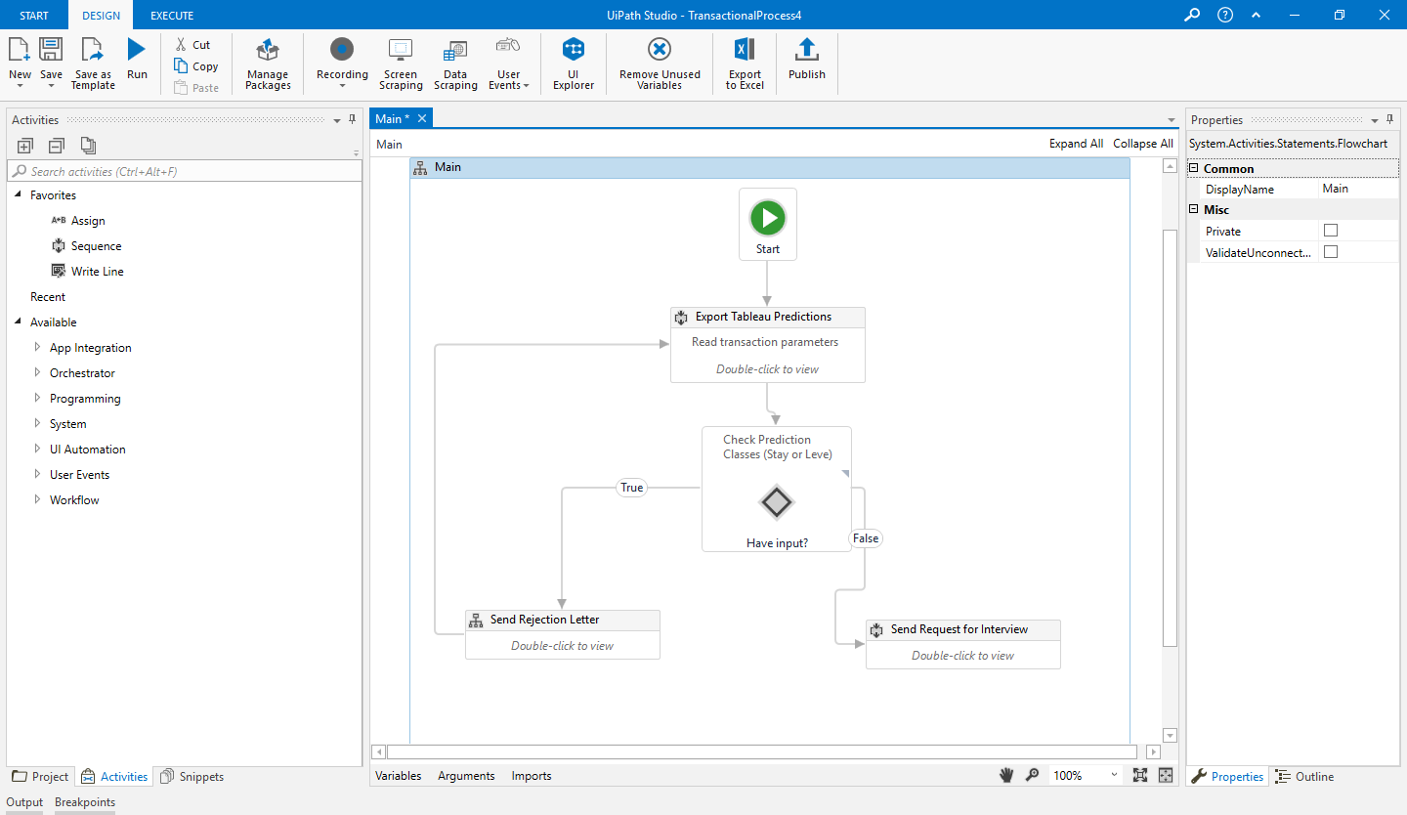
Example of UI Path RPA Workflow to Automate the Contacting of Candidates for Interviews

Slide 41

(World)
(Focus)
(Memory Storage)
Instrumentation
Sensors
Systems of Record
Instrument Measurements
Process
Data
Business Operations
Big
Data
Structured & Unstructured Data
Machine Learning (Best Model)
CRM System
ERP System
HCM System
Historical Database
Specifications
(If…Then…Else)
Model
Maintenance
Salience
Predictions
Automation
Human
Judgment
Process
Goal
Attainment
-Visualization
-Analytics
-Variance
Decision Making Based Upon Probabilistic Outcomes
Process Actions Toward Goal
AI Business
Value From More Efficient and Effective Execution (i.e. Value Props)
P(H|E)
Updates
-Adapted from Kanerva 1989
-Glimcher 2011
-
A Block Diagram of a System of Intelligence For Enterprise Processes
The Complete Perception-Action Cycle of AI

Slide 42
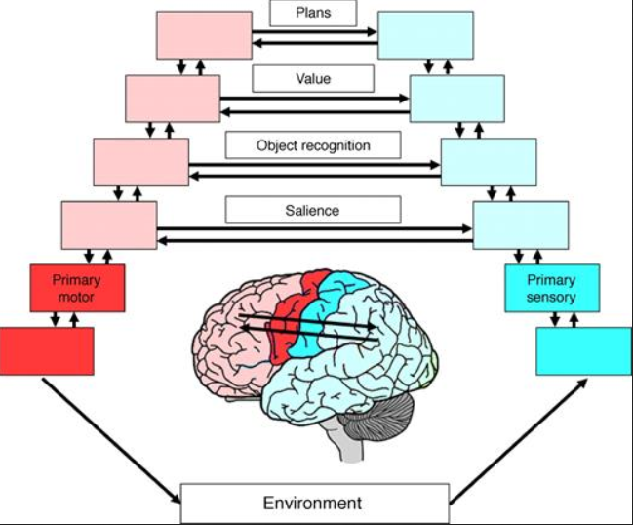
Components of An Intelligent System—A Biological Perspective
Layers of the Cortex
Muscles
Senses
Action
Behavior
Language
Touch
Smell
Taste
Vision
Audition
Goal Directed Perception-Action Cycle
Author: Fuster 2003

Slide 43
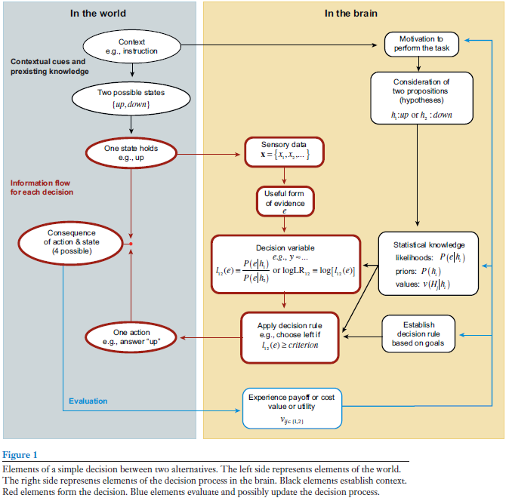
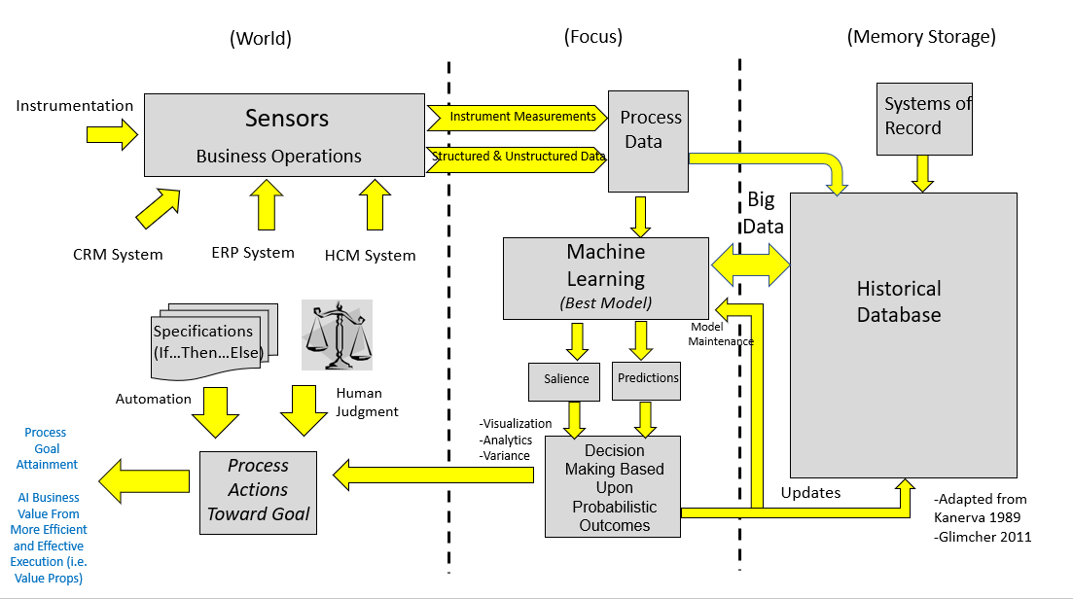

Neuro Scientists such as Glimcher (2011) and Gold/Shadlen (2007) point out the neuro basis of decision making follows a probabilistic process which includes expected value, utility and expected risk. Yet, actual execution is subject to motivation, incomplete search, biases and “random” components leading to suboptimality toward goal achievement.
This idea supports usage of machine learning as a vehicle to augment human decision making with the capability of handling large quantities of data and immense computing power.

Slide 44
An Example of What Gets Covered in MDS 562
Using Intelligent Automation To
Improve Managerial Performance On Customer Projects
John Aaron
03/12/2020
Version 10

Slide 45
Simulation Can Be a Very Important Step In Business Transformation
Formulation of goals
Formulation of models and gathering of information
Implementation of Complex Systems Can Fail If Unanticipated Consequences Are Not Considered
Prediction and extrapolation
Planning of actions; decision making, and execution of actions
Review of effects of actions and revision of strategy
From: “The Logic of Failure”, Dietrich Dorner, 1989.

Slide 46
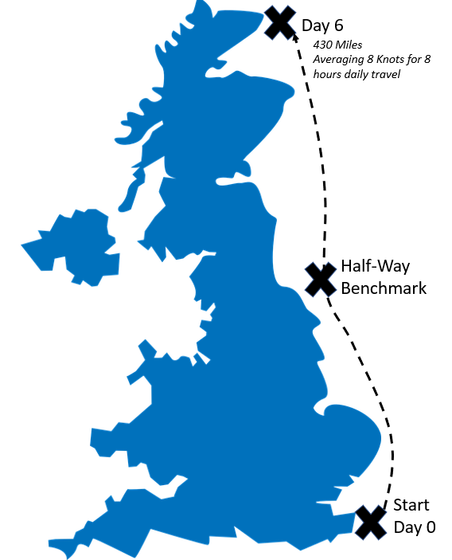


Part 1: Case Study Project
Day 2

Slide 47
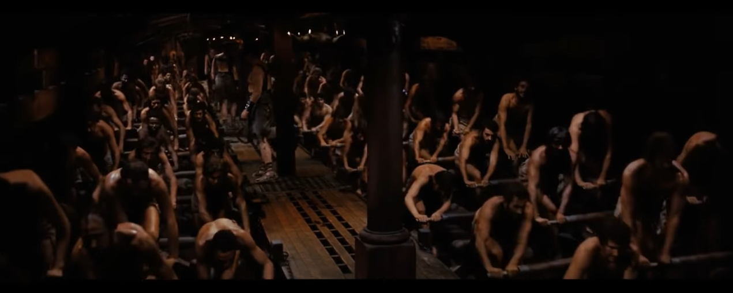
The Captain Decides the Ship’s Crew Must Row

Slide 48
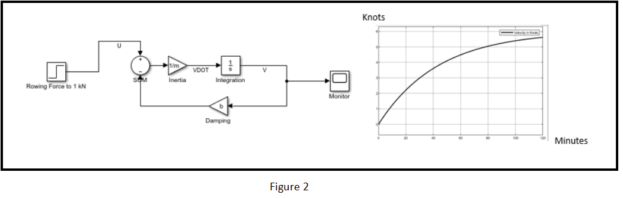
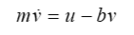
The Captain Is Gifted With Modern Day Technology
Such as MATLAB/Simulink
Applying Governing Equations That Define the Work Process
Adapted From Common Academic Example:
http://ctms.engin.umich.edu/CTMS/index.php?example=CruiseControl&section=SimulinkModeling

Slide 49
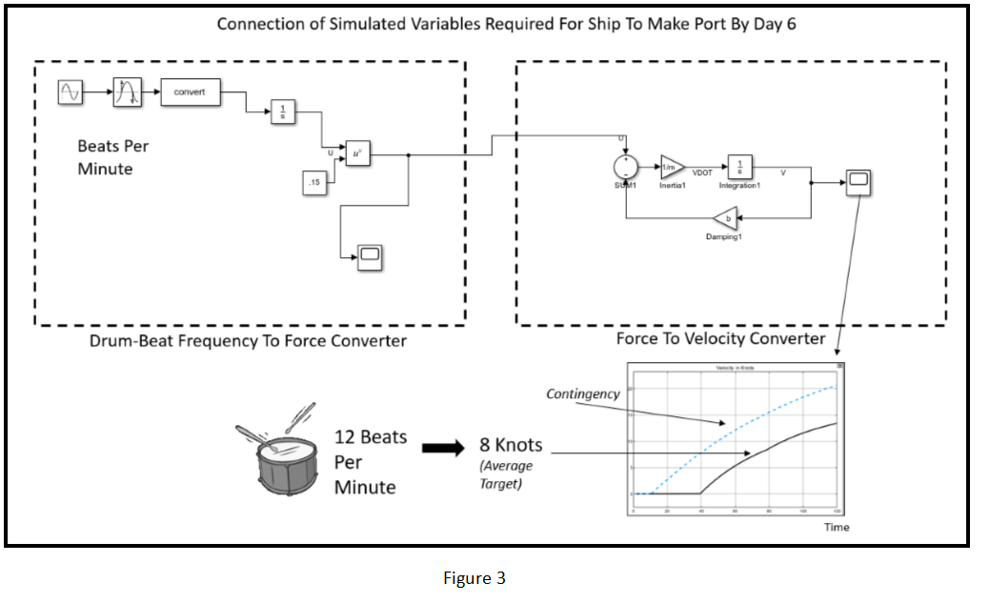
A Complete Solution Often Requires Conversions and Transforms
We Sometimes Refer to These as Transfer Functions

Slide 50
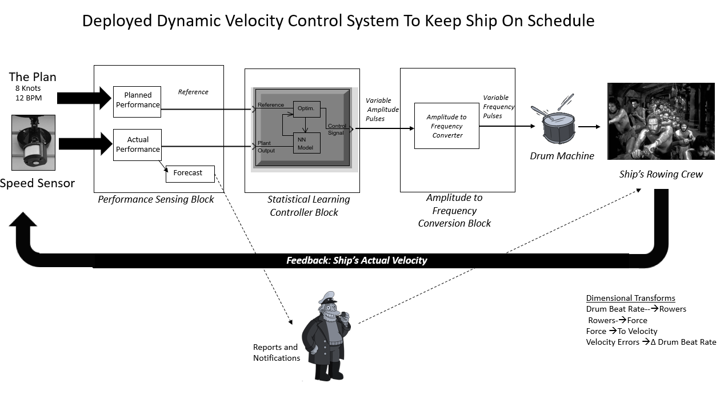

Slide 51
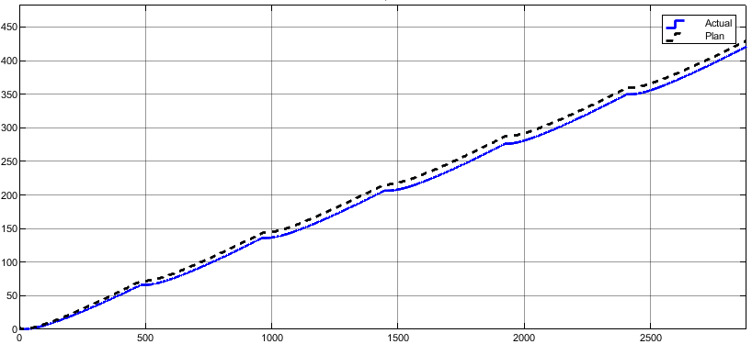
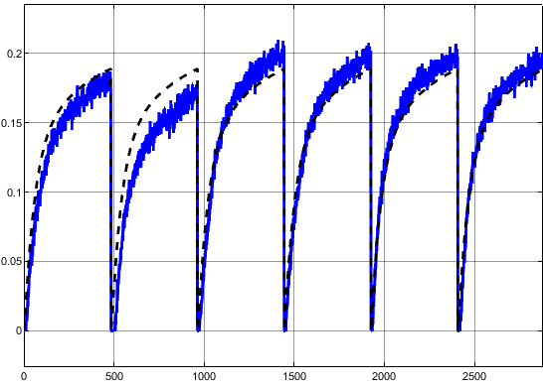
The Controlled Result
Total Distance
Day 6
Day 5
Day 4
Day 3
Day 2
Day 1
Miles Per Minute
Minutes
Bad Weather On Day 2

Slide 52
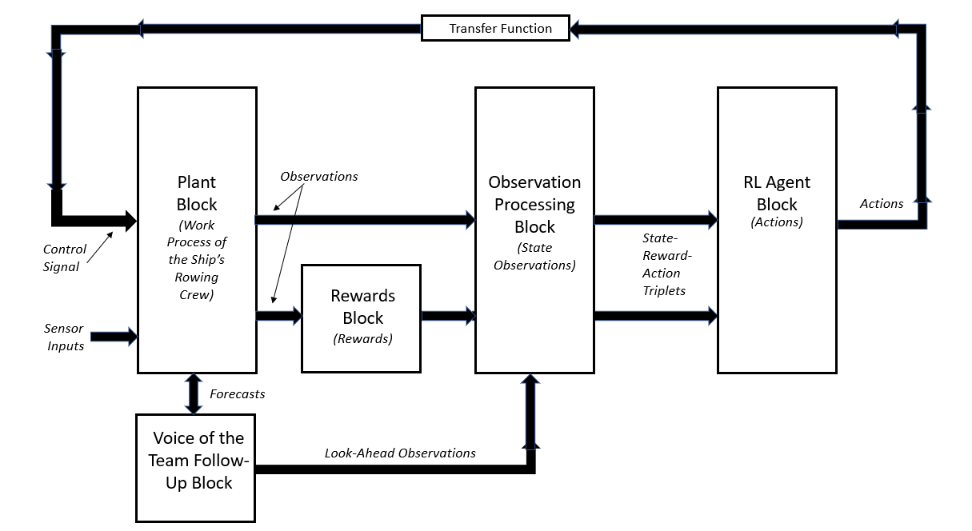
Reinforcement Learning Controller

Slide 53


Greater Accuracy and Reduced Tuning Time Using RL

Slide 54
Enterprise Solutions Are IT Intensive Projects

Slide 55


Keep in Mind Scope Management and Change Control
Deployment as a web service on the Cloud—Microsoft Azure

Slide 56


Slide 57

Azure Machine Learning
The idea of deployment to production in a few clicks is interesting.

Slide 58


Slide 59

Microsoft Azure Example
https://www.youtube.com/watch?v=hXG_zvpaZF4
https://www.youtube.com/watch?v=joTvtoMAc-A

Slide 60

https://azure.microsoft.com/en-us/services/machine-learning-service/

Slide 61

Underlying Philosophy: Multiple Models to Choose From. They Stay Away from the Messy Details of Coefficients and Details of the Prediction Equation. Work with Model “Images”

Slide 62

Example 2 AWS Suite
https://www.youtube.com/watch?v=R0vC31OXt-g

Slide 63


Slide 64

Sample AWS Workflow

Slide 65

All Assignments are Due by Monday, August 3rd at 12:00 noon.

